Slide 1

DAIL YOUR CAR
Objectives:
System Designed Specially for three Different Ranges of Car Rental System.
Car Rental System Provides the functionality of Listing and Hiring a Car .
Project Associates
M.Sahithi
M.V.Naga Prasanth

Slide 2
Literature Review
Inputs from Instructors.
https:// www.zoomcar.com/ https://www.rentalcars.com
homologous websites and Documents

Slide 3
Abstract:-
Our aim is to design a user friendly data management system for a car rental company having three different types of cars ranging according to price/km (Economy, Ultra, Premium) which enables end users to rent vehicles for a temporary period (prepaid rented car) and return them back. By using this system customer should create an account and logged in, to manage their Bookings also provide feedback about their Bookings.
An Administrator on other side can able to insert as well update and delete data which already been inserted, Along with this an administrators can prevail to view user profile who were registered and hired a car. Also an administrator can view feedback provided by the customers.
Technologies Used:-
Backend technologies:
Java
API
Servlets
Log4J
Front End
HTML
CSS
Java Script
Bootstrap
Server
Apache Tomcat
Build Tool
Maven
Database: MySQL
Version Control: GitHub

Slide 4
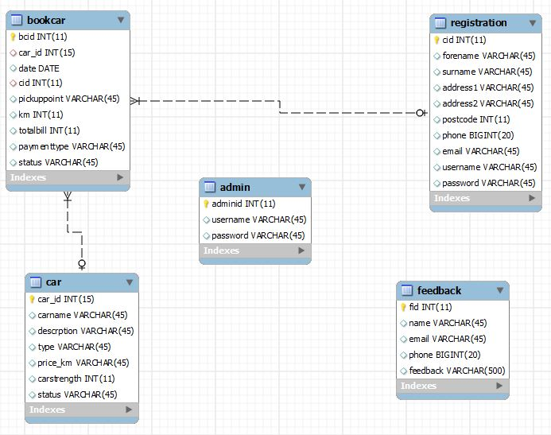
Entity Relationship Diagram

Slide 5
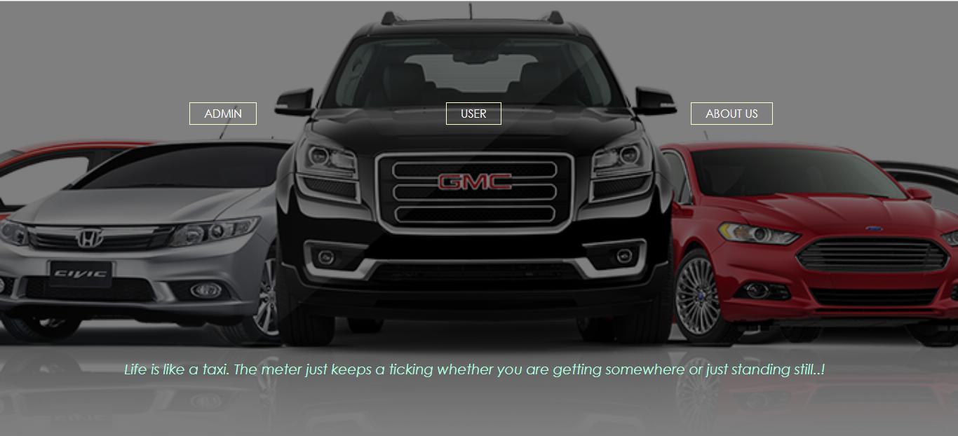
Functional Specifications
Admin
Admin can add a car , manage the data like view, update and
delete.
User
User can view information of available car, booking car, easily
get the car on rent and also give feedback.

Slide 6

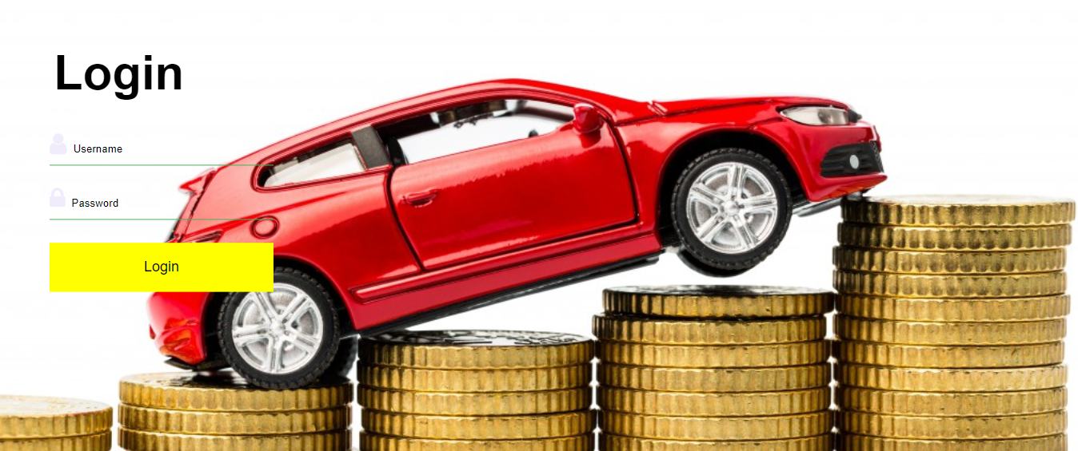
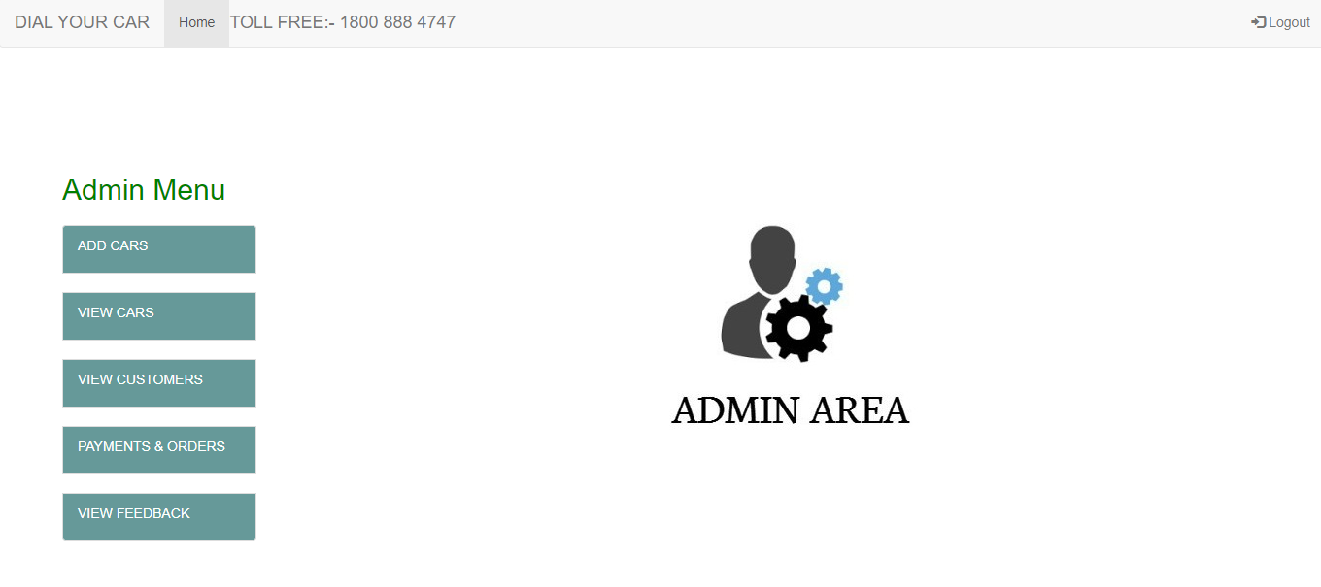
Module Specifications-Admin
The Admin can adds, can manage the rent so that, User can see the rent and book the car. Admin easily view payments and the feedbacks and solve the issues.

Slide 7
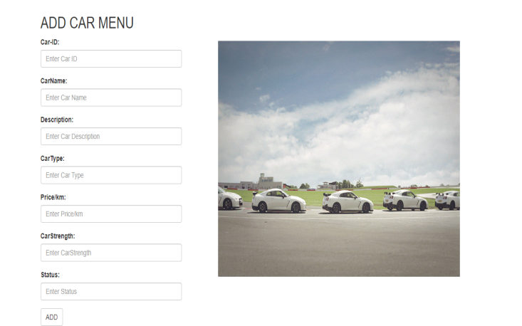
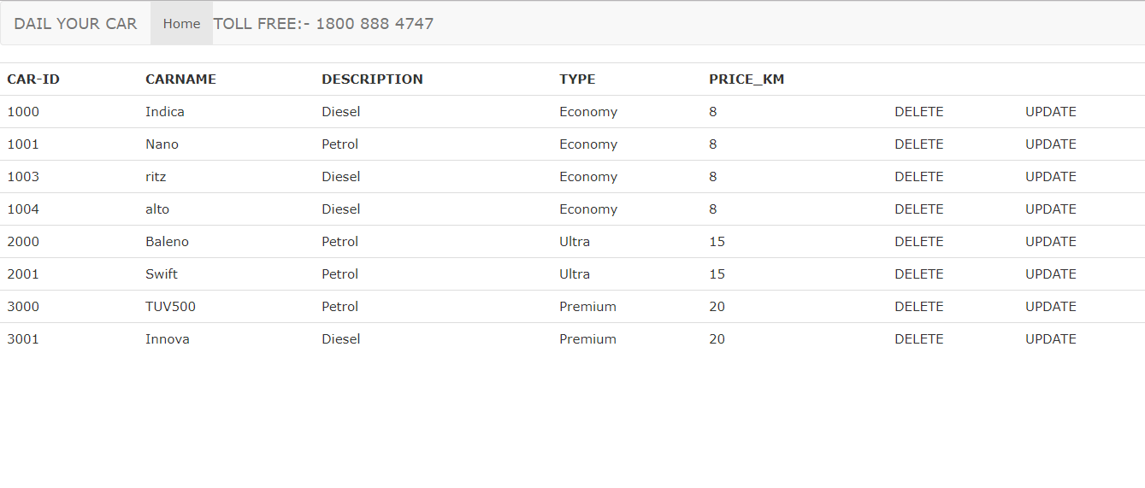
Module Specifications-Admin
Inserting Car Details
View ,Update & Delete Operations

Slide 8
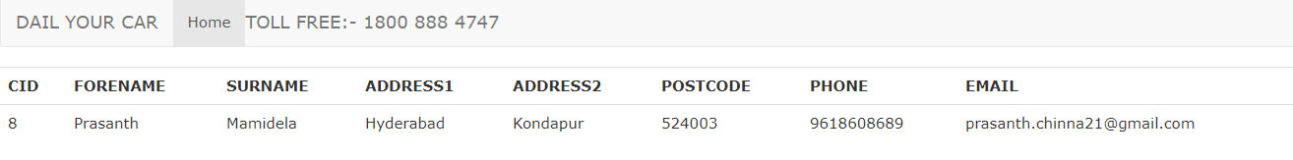
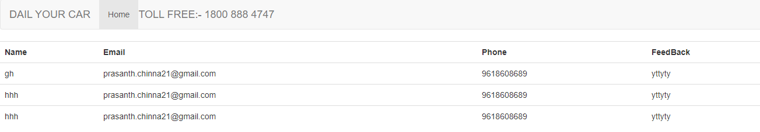
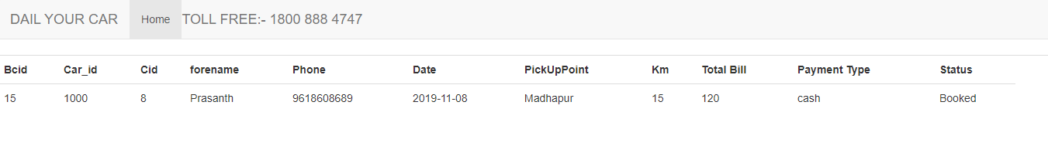
Module Specifications-Admin
User Profile
Feedback
Payments and Orders Information

Slide 9
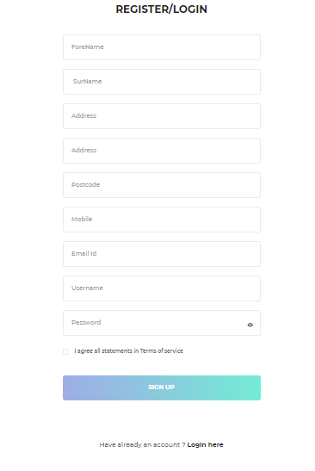
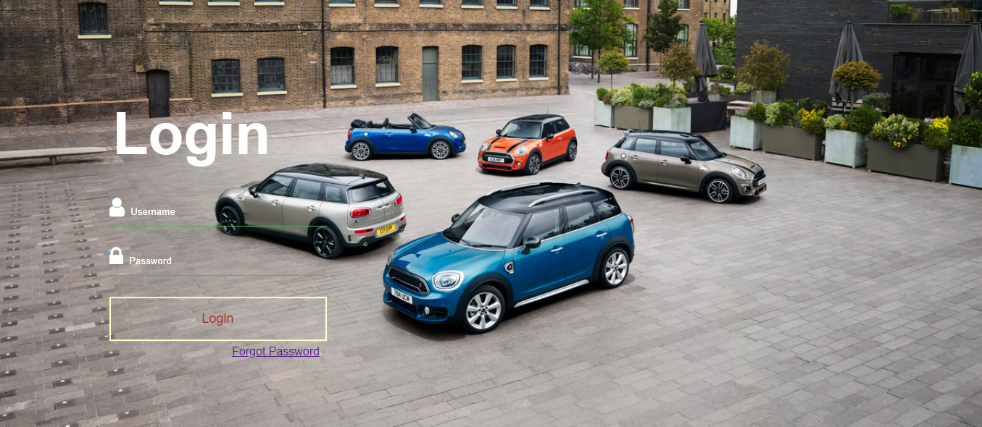
Module Specifications-User
User Registration Followed by Login

Slide 10
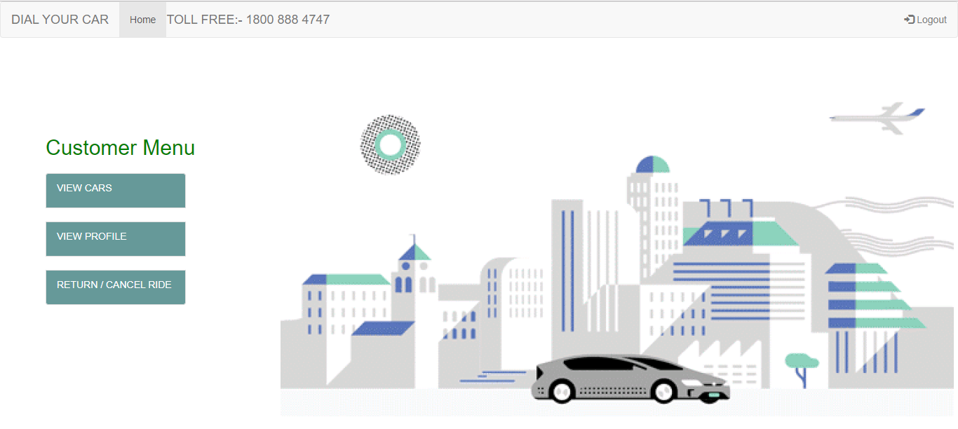
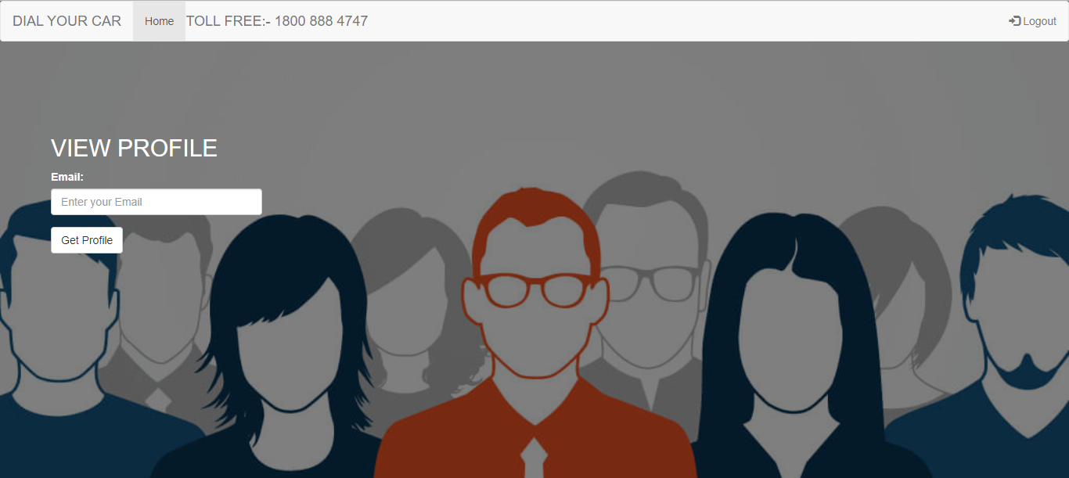
Module Specifications-User
User Menu
Getting Customer Profile using Email

Slide 11
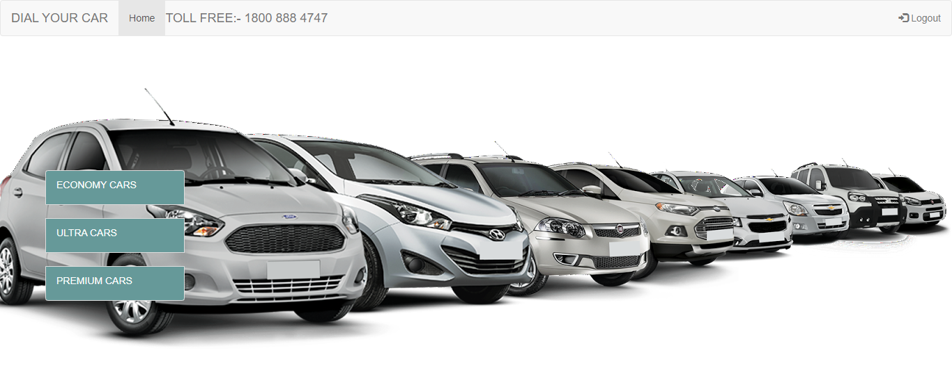
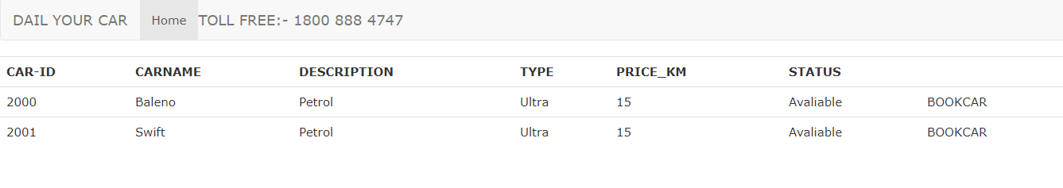
Module Specifications-User
Cars Ranging
Booking Section

Slide 12
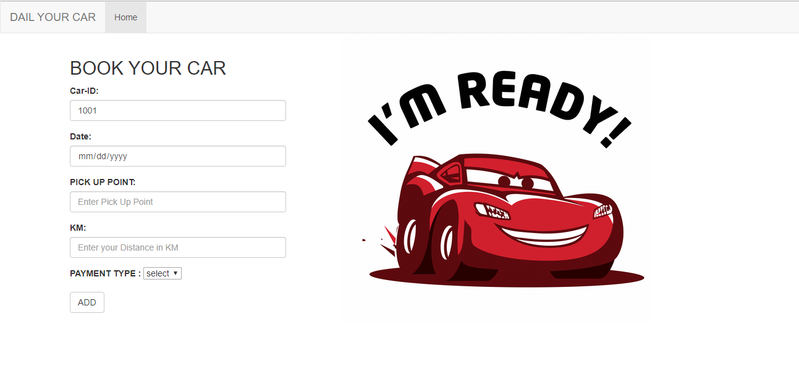
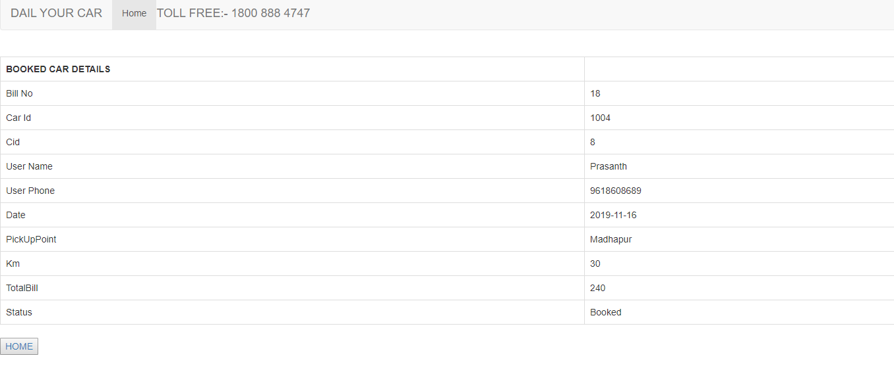
Module Specifications-User
Booking Form
Bill Generation

Slide 13
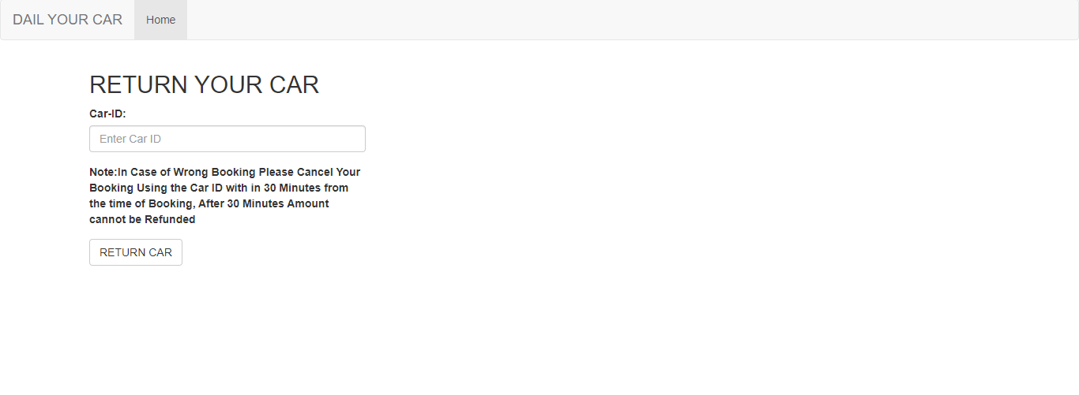
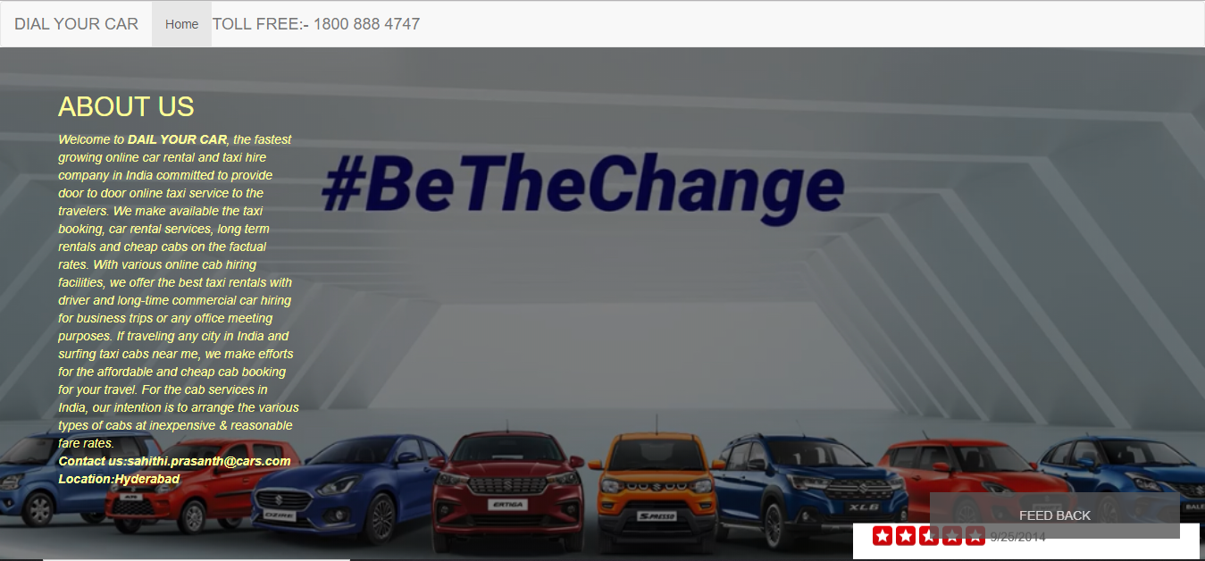
Module Specifications-User
Return Form
About Us

Slide 14
Research and Development
Diversification
Navigation system
Payment Gateway
Email API

Slide 15

THANK YOU

Slide 16


